Slide 1
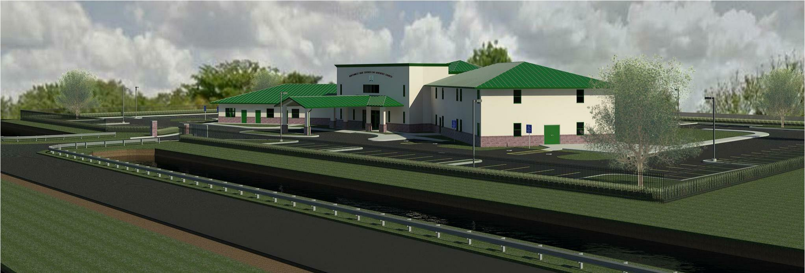
Northwest Dade Seventh Day Adventist Church
Pastor Marlon Gregory
305-974-4945
6500 NW 202 St. Miami, Fl. 33015

Slide 2
We’re glad you joined us!!

Slide 3
Welcome

Slide 4
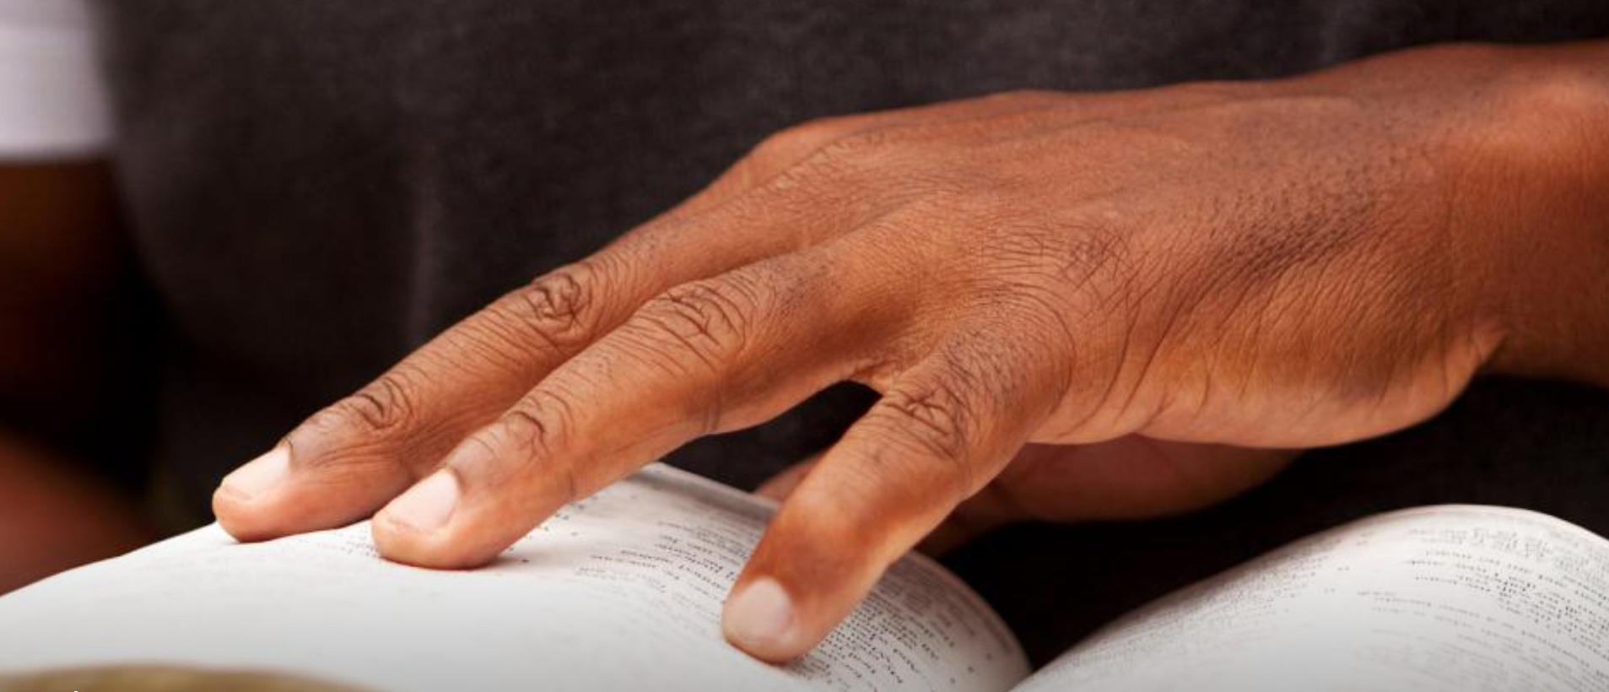
ABSG.Adventist.org
An official website of the Seventh-day Adventist World Church

Slide 5
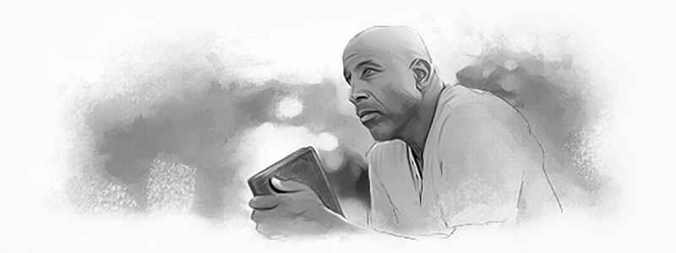
Lesson 9 Aug 19 - 25
Living Wisely

Slide 6
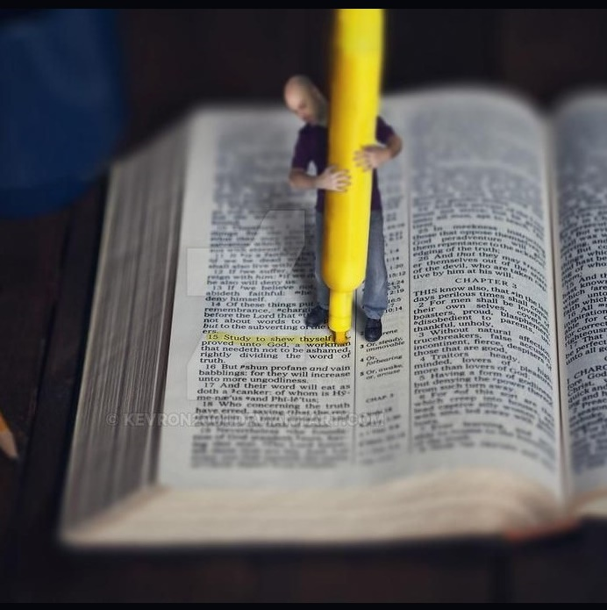
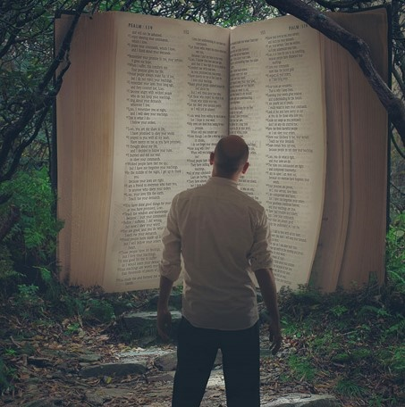
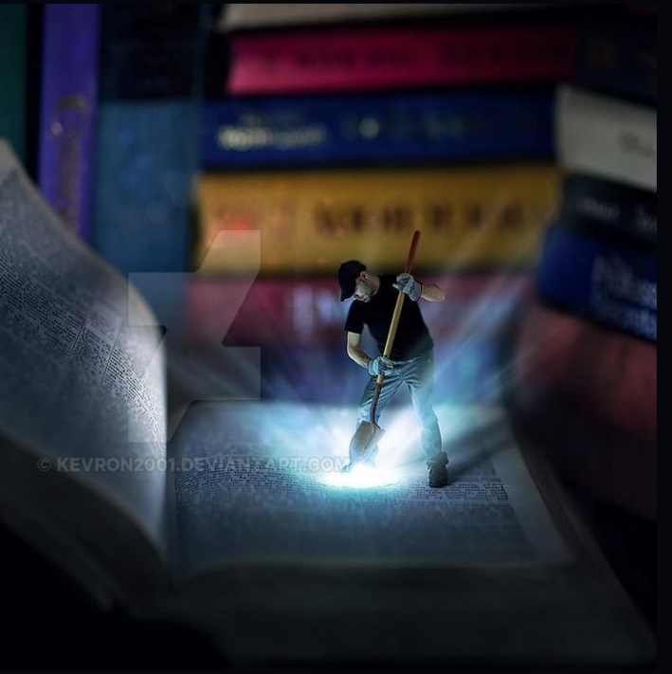
LIVING WISELY
Lesson 9 for August 26, 2023

Slide 7
“Look carefully then how you walk, not as unwise but as wise, making the best use of the time, because the days are evil. Therefore do not be foolish, but understand what the will of the Lord is” (Ephesians 5:15-17, ESV)

Slide 8
“Wherever there is union with Christ there is love […] When we are united to Christ, we have the mind of Christ. Purity and love shine forth in the character, meekness and truth control the life. The very expression of the countenance is changed […] If we are connected with the Light, we shall be channels of light, and in our words and works we shall reflect light to the world. Those who are truly Christians are bound with the chain of love which links earth to heaven, which binds finite man to the infinite God. The light that shines in the face of Jesus Christ shines in the hearts of His followers, to the glory of God.”
E. G. W. (Selected Messages, book 1, Ch. 51, p. 337)

Slide 9
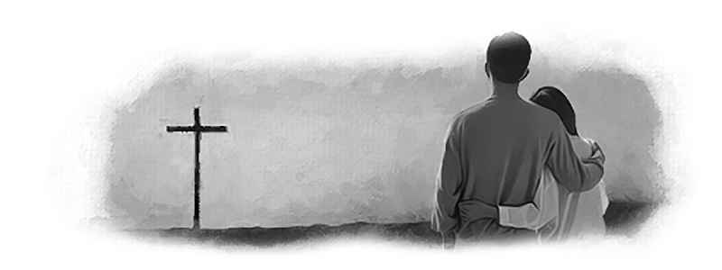
Lesson 10 Aug 26 – Sept 1
Husbands and Wives: Together at the Cross

Slide 10
ABSG.Adventist.org
An official website of the Seventh-day Adventist World Church

Slide 12
Welcome

Slide 13
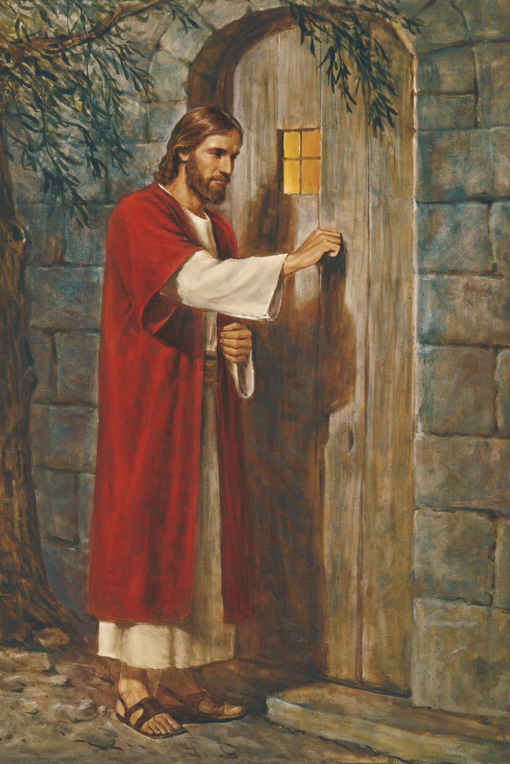
Behold I stand at the door and knock….
Rev 3:20
Divine Worship
Starts @ 1120

Slide 15
PLEASE HELP OUR
PATHFINDERS
GET TO
GILETTE, WYOMING
MARK YOUR DONATION
“GILETTE”

Slide 18
We’re glad you joined us!!

Slide 20
Bible Study
Richard McKenzie
Living On The Brink
Of Eternity
5 PM

Slide 21
PLEASE HELP OUR
PATHFINDERS
GET TO
GILETTE, WYOMING
MARK YOUR DONATION
“GILETTE”

Slide 25
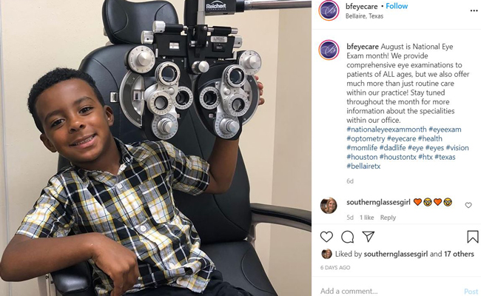

Slide 26
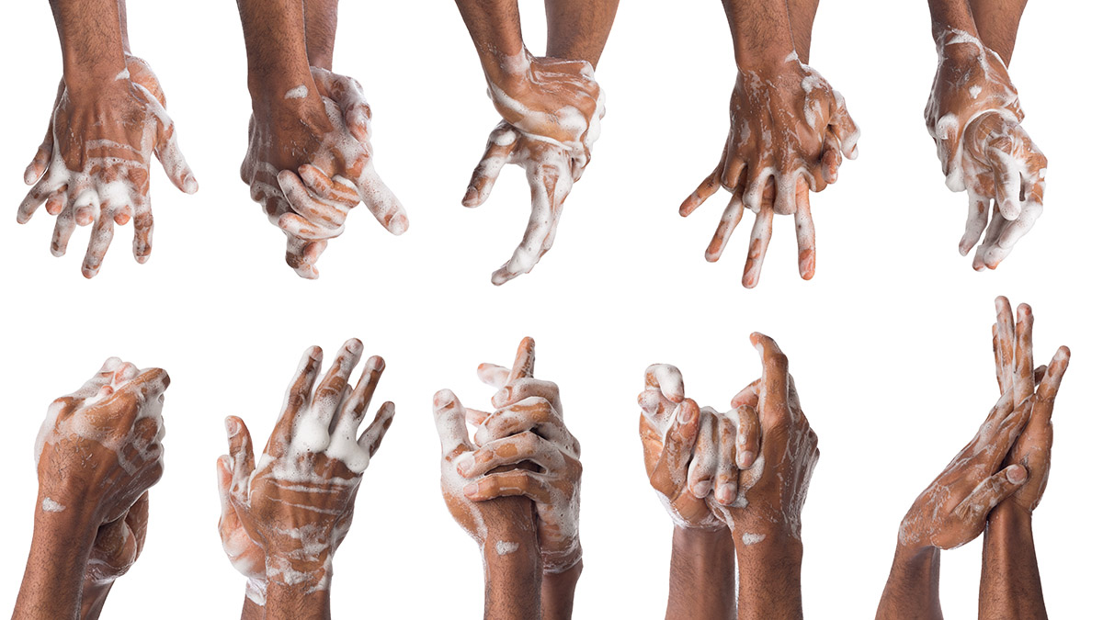
HAND WASHING IS A GOOD WAY TO CUT
DOWN ON VIRUS TRANSFER

Slide 28
Joan Rose Morales 14
Myron Walters 14
Vanessa Hamzat 16
David Perry 16
Jackson Saintagne 16
Victor Dike 17
Barbara Stewart 17
Keneta McCalla 18
Beverly Stone Morgan 19
Zendya Douglas 19
Maria Parente 19
Philomene Robinson 25
karleah Scarlett 26
Marco Valenca 29
Estella Bajoo 30
Deserien Hines 30
Derrick Colas 31
August Channel Hurlston 1
Elisabeth Momplaisir 1
Christopher Paul 2
Raina Simon 3
Jean Lubin 6
Nathaniel Best 10
Yvonne Chung 10
Ryan Simon 11
Beata Quintana 13
Brandon Clemons 14

Slide 29
You are invited to join our Seniors
as they fellowship and pray
11am every Wednesday on the prayer line
848.220.3100
PW: 6500202#

Slide 30
Grab your hymnal, find your favorite song and join us each Sabbath afternoon at 3:30pm – 4:30pm as we sing and praise the Lord together.
848.220.3100
PW: 6500202#

Slide 31
Mon–Fri weekly prayer: 6:00am & 6:00pm
Wednesday Evening: 7:30pm – 8:30pm - Zoom
Sabbath Mornings: 9am – 10am
Prayer Line: 848.220.3100 Conference ID: 6500202#

Slide 32
Join us on Zoom every Wednesday evening at 730pm – Meeting ID: 307 954 563

Slide 33
PRAYER MINISTRY IS AN EVERYDAY MINISTRY
As a need arises, visit our church website
@nwdsda.org
On the main menu, click the “Prayer Request” tab
Complete the Prayer Request Form
Click Submit and you’re done
We are available to pray for you 24 hours – 7 days a week

Slide 34
JOIN MOMS IN PRAYER
SUNDAY September 3rd @ 9AM VIA ZOOM
EVERY CHILD NEEDS A PRAYING MOM

Slide 35
Are You Ready? Be Ready. Stay Ready!
Its never to early to start preparing Hurricane Season starts June 1st-November 30th
It doesn’t take a Hurricane to have a disaster
Make sure you have a family plan that includes your pets
Visit Fema.gov for more information on how to prepare

Slide 36
Be Ready…Stay Ready…
Interested in serving your community in the time of a disaster?
Ministry opportunities and training available.
Contact-Leslie Lobel-DR Coordinator @ 305.586.7118 or
Elder Joel Newman @ 954.822.2231 or Sonia Gollab Newman @ 954.513.9310
Interested in providing financial support?
You can donate online to your local North West Dade church @
www.nwdsda.org or donate to the North American Division @ www.communityservices.org
Support the International Mission through ADRA @ www.ADRA.org

Slide 37
Disaster Relief Coordinators
Joel Newman 954.822.2231
Sonia Newman 954.513.9310
Leslie Lobel 305.586.7118

Slide 38
Bible Study
Richard McKenzie
Living On The Brink
Of Eternity
5 PM

Slide 39
PLEASE HELP OUR
PATHFINDERS
GET TO
GILETTE, WYOMING
MARK YOUR DONATION
“GILETTE”

Slide 44
HAND WASHING IS A GOOD WAY TO CUT
DOWN ON VIRUS TRANSFER

Slide 46
Joan Rose Morales 14
Myron Walters 14
Vanessa Hamzat 16
David Perry 16
Jackson Saintagne 16
Victor Dike 17
Barbara Stewart 17
Keneta McCalla 18
Beverly Stone Morgan 19
Zendya Douglas 19
Maria Parente 19
Philomene Robinson 25
karleah Scarlett 26
Marco Valenca 29
Estella Bajoo 30
Deserien Hines 30
Derrick Colas 31
August Channel Hurlston 1
Elisabeth Momplaisir 1
Christopher Paul 2
Raina Simon 3
Jean Lubin 6
Nathaniel Best 10
Yvonne Chung 10
Ryan Simon 11
Beata Quintana 13
Brandon Clemons 14

Slide 47
You are invited to join our Seniors
as they fellowship and pray
11am every Wednesday on the prayer line
848.220.3100
PW: 6500202#

Slide 48
Grab your hymnal, find your favorite song and join us each Sabbath afternoon at 3:30pm – 4:30pm as we sing and praise the Lord together.
848.220.3100
PW: 6500202#

Slide 49
Mon–Fri weekly prayer: 6:00am & 6:00pm
Wednesday Evening: 7:30pm – 8:30pm - Zoom
Sabbath Mornings: 9am – 10am
Prayer Line: 848.220.3100 Conference ID: 6500202#

Slide 50
Join us on Zoom every Wednesday evening at 730pm – Meeting ID: 307 954 563

Slide 51
PRAYER MINISTRY IS AN EVERYDAY MINISTRY
As a need arises, visit our church website
@nwdsda.org
On the main menu, click the “Prayer Request” tab
Complete the Prayer Request Form
Click Submit and you’re done
We are available to pray for you 24 hours – 7 days a week

Slide 52
JOIN MOMS IN PRAYER
SUNDAY September 3rd @ 9AM VIA ZOOM
EVERY CHILD NEEDS A PRAYING MOM

Slide 53
Are You Ready? Be Ready. Stay Ready!
Its never to early to start preparing Hurricane Season starts June 1st-November 30th
It doesn’t take a Hurricane to have a disaster
Make sure you have a family plan that includes your pets
Visit Fema.gov for more information on how to prepare

Slide 54
Be Ready…Stay Ready…
Interested in serving your community in the time of a disaster?
Ministry opportunities and training available.
Contact-Leslie Lobel-DR Coordinator @ 305.586.7118 or
Elder Joel Newman @ 954.822.2231 or Sonia Gollab Newman @ 954.513.9310
Interested in providing financial support?
You can donate online to your local North West Dade church @
www.nwdsda.org or donate to the North American Division @ www.communityservices.org
Support the International Mission through ADRA @ www.ADRA.org

Slide 55
Disaster Relief Coordinators
Joel Newman 954.822.2231
Sonia Newman 954.513.9310
Leslie Lobel 305.586.7118

Slide 58
We
Worship
With
Song

Slide 59
Angus Dei

Slide 60
Alleluia Alleluia For the Lord God Almighty reigns

Slide 61
Alleluia Alleluia For the Lord God Almighty reigns

Slide 62
Alleluia Holy, Holy Are You Lord God
Almighty Worthy is the Lamb Worthy is the Lamb

Slide 63
You are holy, holy Are you Lord God
Almighty Worthy is the Lamb Worthy is the Lamb

Slide 64
Amen

Slide 65
Alleluia Alleluia For the Lord God Almighty reigns

Slide 66
Alleluia Alleluia For the Lord God Almighty reigns

Slide 67
Alleluia Holy, Holy Are You Lord God
Almighty Worthy is the Lamb Worthy is the Lamb

Slide 68
You are holy, holy Are you Lord God
Almighty Worthy is the Lamb Worthy is the Lamb

Slide 69
Amen

Slide 71
You Are God Alone

Slide 72
You are not a God, created by human hands
You are not a God, dependent on any mortal man
You are not a God, in need of anything we can give
By Your plan, that's just the way it is

Slide 73
You are not a God, created by human hands
You are not a God, dependent on any mortal man
You are not a God, in need of anything we can give
By Your plan, that's just the way it is

Slide 74
You are God alone from before time began
You were on Your throne
You are God alone and right now
In the good times and bad
You are on Your throne
And you are God alone

Slide 75
You're the only God whose power none can contend
You're the only God whose name and praise will never end
You're the only God who's worthy of everything we can give
You are God and that's just the way it is

Slide 76
You are God alone from before time began
You were on Your throne
You are God alone and right now
In the good times and bad
You are on Your throne
And you are God alone

Slide 77
Unchangeable, unshakable, unstoppable
That's what You are
Unchangeable, unshakable, unstoppable
That's what You are

Slide 78
You are God alone from before time began
You were on Your throne
You are God alone and right now
In the good times and bad
You are on Your throne
And you are God alone

Slide 79
Unchangeable, unshakable, unstoppable
That's what You are

Slide 81
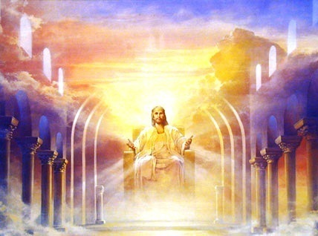
The Lord Is in His Holy Temple
George F. Root (1820-1895)

Slide 82
The Lord Is in His Holy Temple

Slide 83
Let all the earth keep silence,

Slide 84
Let all the earth keep silence before Him

Slide 85
Keep silence,
Keep silence,
Before Him.

Slide 86
Amen.

Slide 88
We
Request
His Presence

Slide 89
Opening
Song

Slide 90
Crown Him With Many Crowns
Hymn #223
Matthew Ridges, 1851 (1800-1894, and
Rev. by Godfrey Throng, 1874 (1823-1903)
George J. Elvey, 1868 (1816-1893)

Slide 91
Crown Him With Many Crowns
Hymn #223

Slide 92
Crown Him with many crowns,
1

Slide 93
The Lamb upon His throne;
1

Slide 94
Hark! How the heavenly anthem drowns
1
1

Slide 95
All music but its own!
1

Slide 96
Awake, my soul, and sing
1

Slide 97
Of Him who died for thee;
1

Slide 98
And hail Him as thy matchless King
1

Slide 99
Through all eternity.
1

Slide 100
Crown Him the Lord of love!
2

Slide 101
Behold His hands and side,
2

Slide 102
Those wounds, yet visible above,
2

Slide 103
In beauty glorified;
2

Slide 104
No angel in the sky
2

Slide 105
Can fully bear that sight,
Can fully bear that sight,
2

Slide 106
But downward bends his wondering eye
2

Slide 107
At mysteries so great.
2

Slide 108
Crown Him the Lord of peace!
3

Slide 109
Whose hand a scepter sways
3

Slide 110
From pole to pole, that wars may cease,
3

Slide 111
And all be prayer and praise;
3

Slide 112
His reign shall know no end,
3

Slide 113
And round His pierced feet
3

Slide 114
Fair flowers of Paradise extend,
3

Slide 115
Their fragrance ever sweet.
3

Slide 116
Crown Him the Lord of years,
4

Slide 117
The Potentate of time,
4

Slide 118
Creator of the rolling spheres,
4

Slide 119
Ineffably sublime!
4

Slide 120
All hail! Redeemer, hail!
4

Slide 121
For Thou hast died for me;
4

Slide 122
Thy praise shall never, never fail
4

Slide 123
Throughout eternity.
4

Slide 125
We Worship with Tithes
And Offerings

Slide 126
Log into nwdsda.org
Click on “Online Giving”

Slide 127
Log in if you have set up an account
If it’s your first time / set up an account

Slide 128
Once logged in
Follow prompts to fill in your information to donate your tithes & offerings

Slide 129
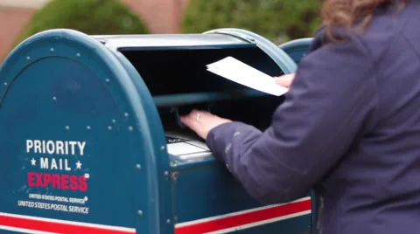
NWD SDA CHURCH
6500 NW 202 ST
MIAMI, FL. 33015

Slide 130
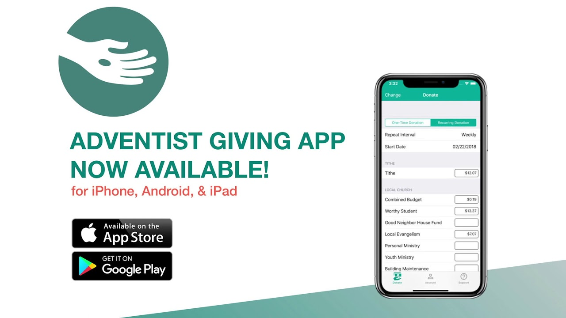

Slide 131
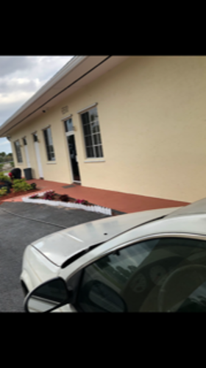
Drop your tithes
on Sabbath while
we are in the building

Slide 132
Log into nwdsda.org
Click on “Online Giving”

Slide 133
Log in if you have set up an account
If it’s your first time / set up an account

Slide 134
Once logged in
Follow prompts to fill in your information to donate your tithes & offerings

Slide 135
NWD SDA CHURCH
6500 NW 202 ST
MIAMI, FL. 33015

Slide 137
Drop your tithes
on Sabbath while
we are in the building

Slide 138
We Worship with Tithes
And Offerings

Slide 139
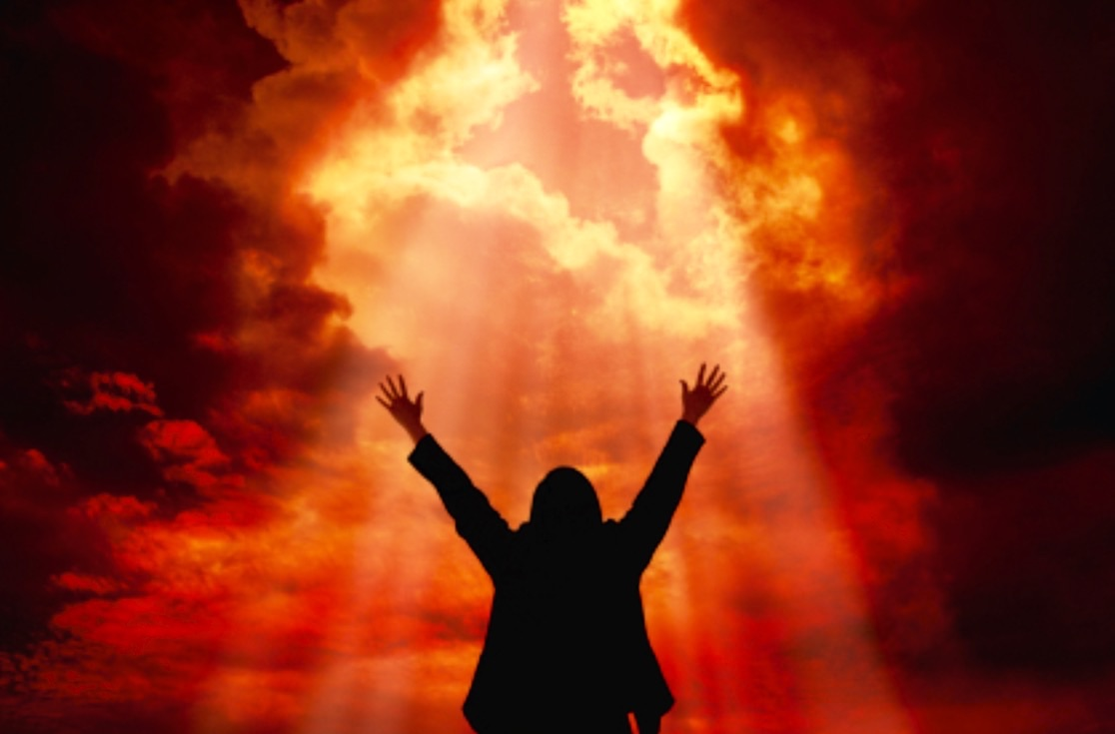
The Lord is Blessing me
Right Now
Oh, right now!

Slide 140
The Lord is Blessing me
Right Now
Oh, right now!

Slide 141
He woke me up
This morning
And He started me
on my way,

Slide 142
The Lord is Blessing me
Right Now!

Slide 143
He’s Blessing me
He’s Blessing me
He’s blessing me
He’s Blessing me

Slide 144
He’s Blessing me
He’s Blessing me
He’s blessing me
He’s Blessing me

Slide 145
The Lord is Blessing
Me
Right Now!

Slide 146
The Lord is Blessing me
Right Now
Oh, right now!

Slide 147
The Lord is Blessing me
Right Now
Oh, right now!

Slide 148
He woke me up
This morning
And He started me
on my way,

Slide 149
The Lord is Blessing me
Right Now!

Slide 150
He’s Blessing me
He’s Blessing me
He’s blessing me
He’s Blessing me

Slide 151
He’s Blessing me
He’s Blessing me
He’s blessing me
He’s Blessing me

Slide 152
The Lord is Blessing
Me
Right Now!

Slide 153
We Worship with Tithes
And Offerings

Slide 154
We Surrender in Prayer

Slide 155
Hover o’er me, Holy Spirit, Bathe my trembling heart and brow;

Slide 156
Fill me with Thy hallowed presence, Come, O come and fill me now.

Slide 157
Fill me now, fill me now, Jesus, come and fill me now.

Slide 158
Fill me with Thy hallowed presence, Come, O come and fill me now.

Slide 159
We Surrender in Prayer

Slide 160
Hear our prayer, O Lord,
1

Slide 161
Hear our prayer, O Lord;
1

Slide 162
Incline Thine ear to us,
1

Slide 163
And grant us Thy peace.
1

Slide 164
Amen.
1

Slide 166
SONG OF PRAISE

Slide 168
We Receive Your Word
“Restoring God’s People”
Kenneth Joseph

Slide 169
Scripture
Reading
Proverbs 22:6

Slide 170
We Receive Your Word
“Restoring God’s People”
Kenneth Joseph

Slide 171
Closing
Hymn

Slide 172
We Praise
Jesus Is
Coming Again
Hymn # 213

Slide 173
Lift up the trumpet, and loud let it ring:
Jesus is coming again!
1

Slide 174
Cheer up, ye pilgrims, be joyful and sing
Jesus is coming again!
1

Slide 175
Coming again, coming again,
Jesus is coming again!
R

Slide 176
Echo it, hilltops; proclaim it, ye plains:
Jesus is coming again!
2

Slide 177
Coming in glory, the Lamb that was slain;
Jesus is coming again!
2

Slide 178
Coming again, coming again,
Jesus is coming again!
R

Slide 179
Heavings of earth, tell the vast, wondering throng:
Jesus is coming again!
3

Slide 180
Tempests and whirlwinds, the anthem prolong;
Jesus is coming again!
3

Slide 181
Coming again, coming again,
Jesus is coming again!
R

Slide 182
Nations are angry-by this we do know
Jesus is coming again!
4

Slide 183
Knowledge increases; men run to and fro;
Jesus is coming again!
4

Slide 184
Coming again, coming again,
Jesus is coming again!
R

Slide 185
R

Slide 186
Benediction

Slide 187
The Lord Be With you….
Till We Meet Again!

Slide 188
I Will Never Be
1995 Word Music, LLC | Maranatha! Music (Admin. by Word Music Group, Inc.) | (Admin. by Music Services)
Geoff Bullock CCLI 1845024

Slide 189
I will never be
the same again
I can never return
I've closed the door

Slide 190
I will walk the path
I will run the race
And I will never be the same again

Slide 191
I will never be
the same again
I can never return
I've closed the door

Slide 192
I will walk the path
I will run the race
And I will never be the same again

Slide 193
Fall like fire
soak like rain
Flow like mighty waters
Again and again

Slide 194
Sweep away the darkness
Burn away the chaff
And let a flame burn
To glorify Your name

Slide 195
There are higher heights
There are deeper seas
Whatever You need to do
Lord do it in me

Slide 196
The glory of God fills my life
And I will never be the same again

Slide 197
Fall like fire
soak like rain
Flow like mighty waters
Again and again

Slide 198
Sweep away the darkness
Burn away the chaff
And let a flame burn
To glorify Your name

Slide 199
Fall like fire
soak like rain
Flow like mighty waters
Again and again

Slide 200
Sweep away the darkness
Burn away the chaff
And let a flame burn
To glorify Your name

Slide 201
Fall like fire
soak like rain
Flow like mighty waters
Again and again

Slide 202
Sweep away the darkness
Burn away the chaff
And let a flame burn
To glorify Your name

Slide 203
I will never be
the same again
I can never return
I've closed the door

Slide 204
I will walk the path
I will run the race
And I will never be the same again

Slide 205
And I will never be the same again

Slide 206
And I will never be the same again

Slide 207
And I will never be the same again

Slide 209
The Lord Be With you….
Till We Meet Again!

Slide 211
Bible Study
Richard McKenzie
Living On The Brink
Of Eternity
5 PM

Slide 212
PLEASE HELP OUR
PATHFINDERS
GET TO
GILETTE, WYOMING
MARK YOUR DONATION
“GILETTE”

Slide 217
HAND WASHING IS A GOOD WAY TO CUT
DOWN ON VIRUS TRANSFER

Slide 219
Joan Rose Morales 14
Myron Walters 14
Vanessa Hamzat 16
David Perry 16
Jackson Saintagne 16
Victor Dike 17
Barbara Stewart 17
Keneta McCalla 18
Beverly Stone Morgan 19
Zendya Douglas 19
Maria Parente 19
Philomene Robinson 25
karleah Scarlett 26
Marco Valenca 29
Estella Bajoo 30
Deserien Hines 30
Derrick Colas 31
August Channel Hurlston 1
Elisabeth Momplaisir 1
Christopher Paul 2
Raina Simon 3
Jean Lubin 6
Nathaniel Best 10
Yvonne Chung 10
Ryan Simon 11
Beata Quintana 13
Brandon Clemons 14

Slide 220
You are invited to join our Seniors
as they fellowship and pray
11am every Wednesday on the prayer line
848.220.3100
PW: 6500202#

Slide 221
Grab your hymnal, find your favorite song and join us each Sabbath afternoon at 3:30pm – 4:30pm as we sing and praise the Lord together.
848.220.3100
PW: 6500202#

Slide 222
Mon–Fri weekly prayer: 6:00am & 6:00pm
Wednesday Evening: 7:30pm – 8:30pm - Zoom
Sabbath Mornings: 9am – 10am
Prayer Line: 848.220.3100 Conference ID: 6500202#

Slide 223
Join us on Zoom every Wednesday evening at 730pm – Meeting ID: 307 954 563

Slide 224
PRAYER MINISTRY IS AN EVERYDAY MINISTRY
As a need arises, visit our church website
@nwdsda.org
On the main menu, click the “Prayer Request” tab
Complete the Prayer Request Form
Click Submit and you’re done
We are available to pray for you 24 hours – 7 days a week

Slide 225
JOIN MOMS IN PRAYER
SUNDAY September 3rd @ 9AM VIA ZOOM
EVERY CHILD NEEDS A PRAYING MOM

Slide 226
Log into nwdsda.org
Click on “Online Giving”

Slide 227
Log in if you have set up an account
If it’s your first time / set up an account

Slide 228
Once logged in
Follow prompts to fill in your information to donate your tithes & offerings

Slide 229
NWD SDA CHURCH
6500 NW 202 ST
MIAMI, FL. 33015

Slide 231
Drop your tithes
on Sabbath while
we are in the building

Slide 232
Are You Ready? Be Ready. Stay Ready!
Its never to early to start preparing Hurricane Season starts June 1st-November 30th
It doesn’t take a Hurricane to have a disaster
Make sure you have a family plan that includes your pets
Visit Fema.gov for more information on how to prepare

Slide 233
Be Ready…Stay Ready…
Interested in serving your community in the time of a disaster?
Ministry opportunities and training available.
Contact-Leslie Lobel-DR Coordinator @ 305.586.7118 or
Elder Joel Newman @ 954.822.2231 or Sonia Gollab Newman @ 954.513.9310
Interested in providing financial support?
You can donate online to your local North West Dade church @
www.nwdsda.org or donate to the North American Division @ www.communityservices.org
Support the International Mission through ADRA @ www.ADRA.org

Slide 234
Disaster Relief Coordinators
Joel Newman 954.822.2231
Sonia Newman 954.513.9310
Leslie Lobel 305.586.7118

Slide 235
Bible Study
Richard McKenzie
Living On The Brink
Of Eternity
5 PM

Slide 236
PLEASE HELP OUR
PATHFINDERS
GET TO
GILETTE, WYOMING
MARK YOUR DONATION
“GILETTE”

Slide 241
HAND WASHING IS A GOOD WAY TO CUT
DOWN ON VIRUS TRANSFER

Slide 243
Joan Rose Morales 14
Myron Walters 14
Vanessa Hamzat 16
David Perry 16
Jackson Saintagne 16
Victor Dike 17
Barbara Stewart 17
Keneta McCalla 18
Beverly Stone Morgan 19
Zendya Douglas 19
Maria Parente 19
Philomene Robinson 25
karleah Scarlett 26
Marco Valenca 29
Estella Bajoo 30
Deserien Hines 30
Derrick Colas 31
August Channel Hurlston 1
Elisabeth Momplaisir 1
Christopher Paul 2
Raina Simon 3
Jean Lubin 6
Nathaniel Best 10
Yvonne Chung 10
Ryan Simon 11
Beata Quintana 13
Brandon Clemons 14

Slide 244
You are invited to join our Seniors
as they fellowship and pray
11am every Wednesday on the prayer line
848.220.3100
PW: 6500202#

Slide 245
Grab your hymnal, find your favorite song and join us each Sabbath afternoon at 3:30pm – 4:30pm as we sing and praise the Lord together.
848.220.3100
PW: 6500202#

Slide 246
Mon–Fri weekly prayer: 6:00am & 6:00pm
Wednesday Evening: 7:30pm – 8:30pm - Zoom
Sabbath Mornings: 9am – 10am
Prayer Line: 848.220.3100 Conference ID: 6500202#

Slide 247
Join us on Zoom every Wednesday evening at 730pm – Meeting ID: 307 954 563

Slide 248
PRAYER MINISTRY IS AN EVERYDAY MINISTRY
As a need arises, visit our church website
@nwdsda.org
On the main menu, click the “Prayer Request” tab
Complete the Prayer Request Form
Click Submit and you’re done
We are available to pray for you 24 hours – 7 days a week

Slide 249
JOIN MOMS IN PRAYER
SUNDAY September 3rd@ 9AM VIA ZOOM
EVERY CHILD NEEDS A PRAYING MOM

Slide 250
Log into nwdsda.org
Click on “Online Giving”

Slide 251
Log in if you have set up an account
If it’s your first time / set up an account

Slide 252
Once logged in
Follow prompts to fill in your information to donate your tithes & offerings

Slide 253
NWD SDA CHURCH
6500 NW 202 ST
MIAMI, FL. 33015

Slide 255
Drop your tithes
on Sabbath while
we are in the building

Slide 256
Are You Ready? Be Ready. Stay Ready!
Its never to early to start preparing Hurricane Season starts June 1st-November 30th
It doesn’t take a Hurricane to have a disaster
Make sure you have a family plan that includes your pets
Visit Fema.gov for more information on how to prepare

Slide 257
Be Ready…Stay Ready…
Interested in serving your community in the time of a disaster?
Ministry opportunities and training available.
Contact-Leslie Lobel-DR Coordinator @ 305.586.7118 or
Elder Joel Newman @ 954.822.2231 or Sonia Gollab Newman @ 954.513.9310
Interested in providing financial support?
You can donate online to your local North West Dade church @
www.nwdsda.org or donate to the North American Division @ www.communityservices.org
Support the International Mission through ADRA @ www.ADRA.org

Slide 258
Disaster Relief Coordinators
Joel Newman 954.822.2231
Sonia Newman 954.513.9310
Leslie Lobel 305.586.7118

Slide 259
The Lord Be With you….
Till We Meet Again!

